Slide 1
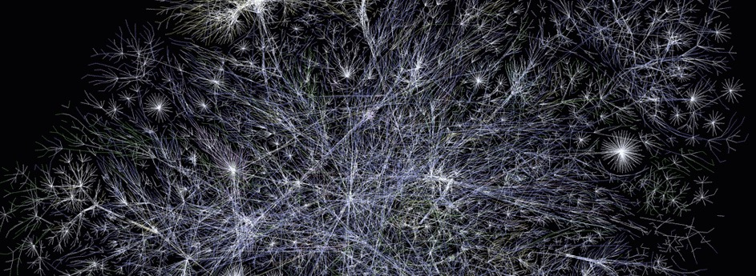
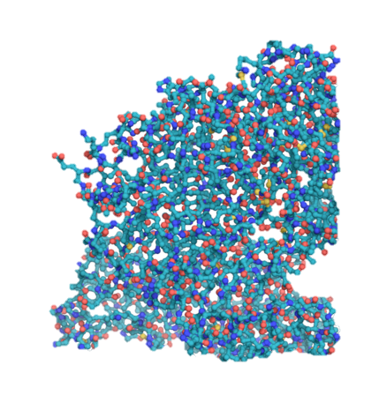

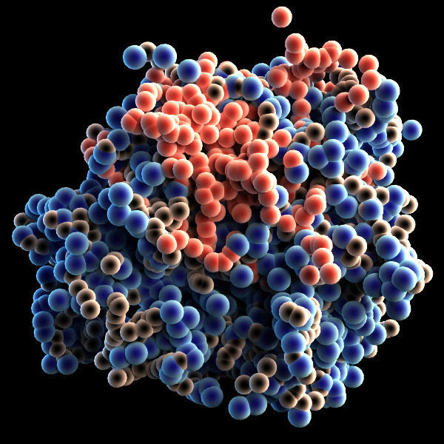
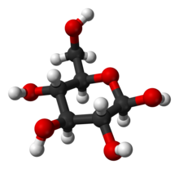
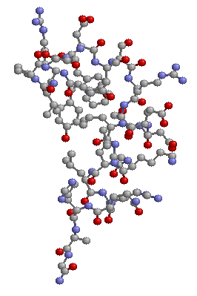


Artificial Chemistries
Basic Concepts
Daniel Rodríguez Cárdenas
Carlos Andrés Sierra
Alife research group,
Universidad Nacional,
Bogotá, Colombia.
Notes:
© Copyright Showeet.com – Free PowerPoint Templates

Slide 2
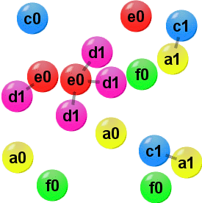
Basic definition
An artificial chemistry (a.c.) is a tool. It is a type of computer model that can be used to simulate different types of systems.
The type of systems that has been modelled with a.c. range from chemistry, biochemistry [McCaskill, 1998], ecology, sociology, linguistic [Dittrich, Ziegler, Banzhaf, 2002]. Also a.c. has been used for practical purposes for example to model a robot brain [Ziegler & Banzhaf, 2001].

Slide 3
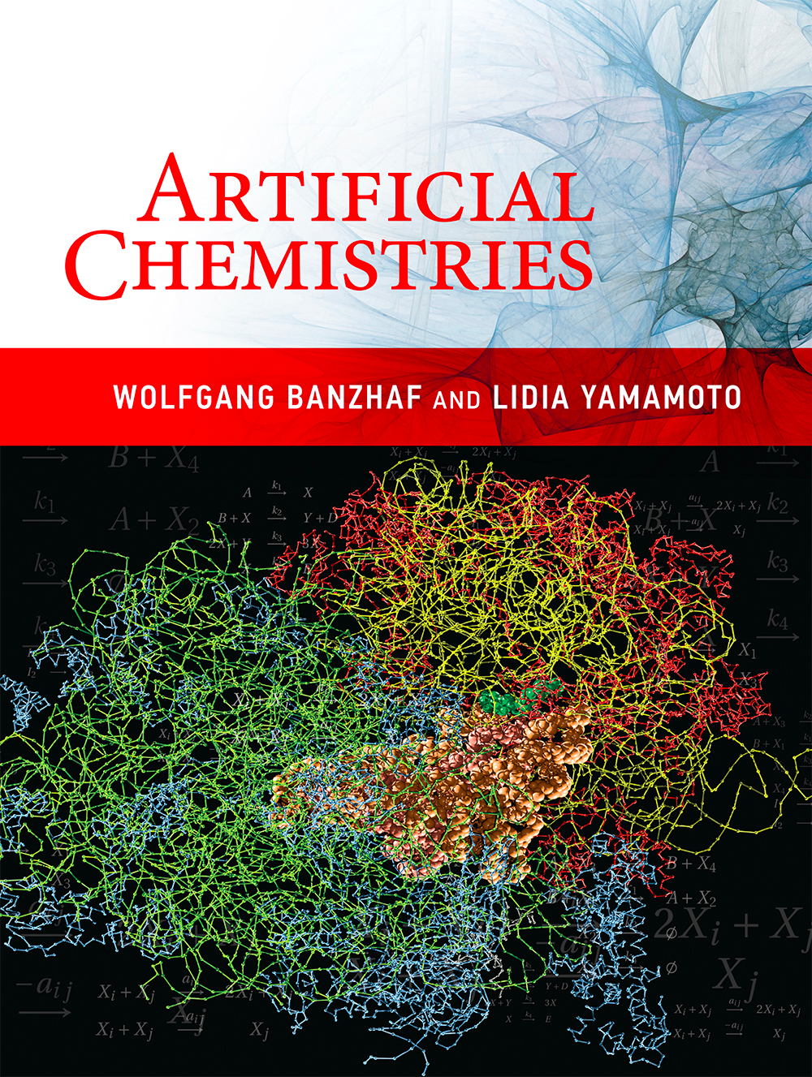
“
The field of Artificial Life is now firmly established in the scientific world. One of the original goals of the Alife field, the understanding of emergence of life on Earth.
Banzhaf Wolfgang

Slide 4
Advantages
The strength of Artificial Chemistries draws from the fact that they offer tools for an examination of both quantitative and qualitative phenomena.

Slide 5
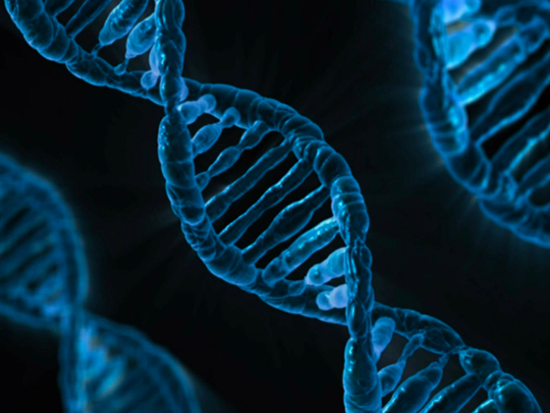
Basic Concepts of Artificial Chemistries (ACs)
ACs originated from the efforts to understand the origins of life.
Reactions: happen when a set of molecules come into contact. Some atoms are broken and other are formed.
Is a tool: to study the dynamics of system of interacting objects in a combinatorial spaces.
The strength: examination of both quantitative and qualitative phenomena.

Slide 6


Slide 7
| Motivation

Slide 8
Artificial life and artificial chemistry
Artificial Life
Artificial Chemistry
Abstracts from specific examples of real living process and tries to integrate different approaches into one interdisciplinary attempt to extract the firs principles of life.
By abstracting from natural molecular processes, tries to investigate the dynamics of these complex systems.

Slide 9
Motivation & Goal
Simulate (bio-)chemical processes, e.g. origin of life from primordial soup of molecules.
Explore alternative computation models: chemical computing.
Understand emerging/self-maintaining structures, e.g. chemical organization theory .

Slide 10
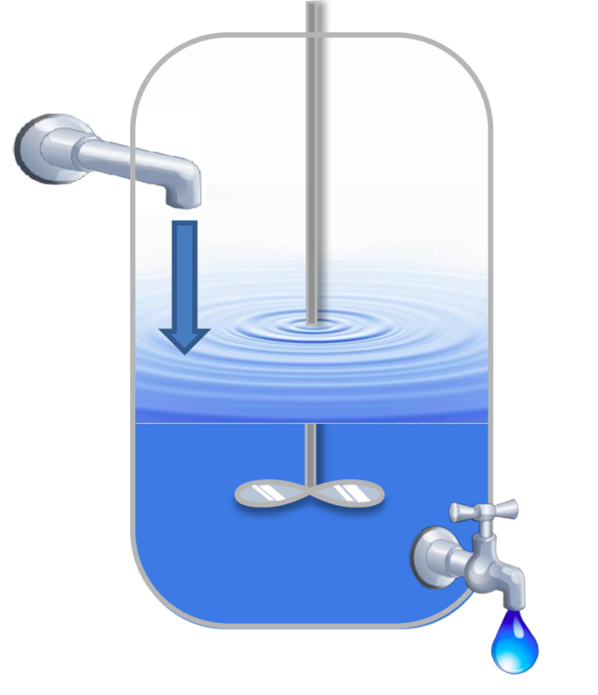
Terminology
Molecular species.
Multiset.
(Well-stirred) Vessel.
Concentration.
Chemical reaction.
Auto-catalytic sets

Slide 11
Basic concepts
Artificial chemistry
Man made system that is similar to real chemical system.
Defined by a trype (S,R,A)
Set of molecules S.
Set of rules R.
Reactor algorithm A – Dynamics.
S: all valid molecules that may appear in an AC.
R: interactions between molecules in S.
A: determines how R is applied to a collection of molecules.

Slide 12
The notion (1)
“ Instead of mathematical operations being executed on symbols without connection to a material world, in an artificial chemistry, operations include a notion of material”
A symbolic equation: 5+6 = 11
5
6
11
A quasi-chemical reaction: 5+6 -> 11

Slide 13
The notion (2)
The first complication:
Reactions are symmetrical
A symbolic equation: 5/6 = NOT Possible
6
5
1
A quasi-chemical reaction: 6/5 -> 1
Since 1.2 is closer to 1
We need an algorithm!!

Slide 14
The set of molecules S- Objects
The set of molcules S = { S₁, …, S_{i} ,… S_{n} }, describes all different valid molecules that might appear in the Artificial Chemistry.
A molecules’ representation is often referred to as its structure and kept apart from its function, which is given by the reaction rules R.
The description of the valid molecules and their structure is usually the first step in the definition of an artificial chemistry.
This is analogous to the part of chemistry that describes what kind of atomic configurations form stable molecules and how these molecules appear.

Slide 15
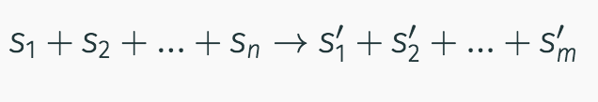
The set of Rules R - Interactions
The set of reaction rules R describes the interactions between molecules.
A rule can be written acording to the chemical notation of reaction rules in the form:
A reaction rule determines the n components on the left hand side that can react and subsequently be replaced by the m components on the right hand side.
A rule is applicable only if certain conditions are fulfilled. The major conditions is that all components written on the left hand side of the rule are avaliable.

Slide 16
Reactor Algorithm A - Dynamics
The reactor algorithm A is in charge of simulating the dynamics of a reaction vessel.
It determines how the set R of rules is applied to a collection of molecules P, called reactor, soup, reaction vessel or population.
S is a being set, P is correctly termed a multiset. The index of S indicates a type of molecule. P indicates a place in the population which could be occupied by any type of molecule.
S
P
c
c
c
a
b
b
a
b
c

Slide 17
More definitions
P
The cardinality of P is the total number of elements:
Card(P) = 6.
The multiplicity of an element is the number of times it appears in the multset.
a = 1
b = 2
c = 3
c
c
b
a
b
c

Slide 18
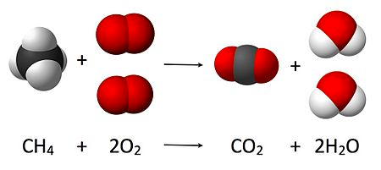
Artificial Chemistries, an snapshoot?
It is not so interesting to see only a snapshot of a chemistry, but rather its changes over the time!

Slide 19
Algortihm A
Algorithm A is conceptually independent of the representation of R and P, its performance and algorithmic complexity will often influenced by R and P represented as data structures in the computer.

Slide 20
Stochastic molecular collisions (1)
A typical algorithm draws a random sample of molecules from the population P, assumes a collision of these molecules and checks whether any rule R can be applied.
If the conditions of a rule r are fulfilled, the molecules are replaced by the molecules on the right-hand side of r.
Notes:
Parámetros constantes tales como la energía, información espacial o la temperatura pueden ser introducidas a la regla para volverla más realista.

Slide 21
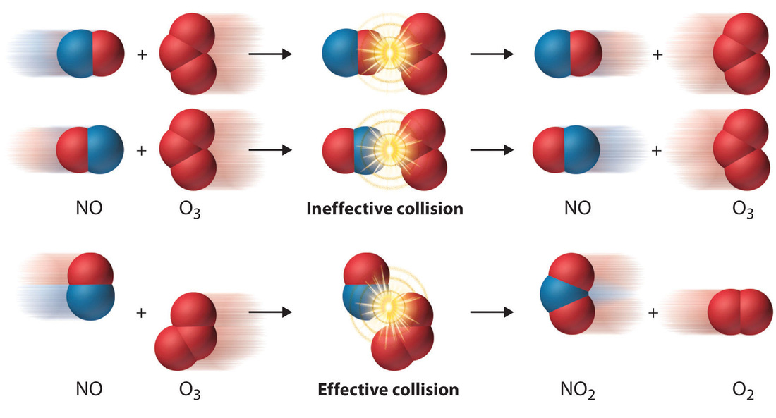
Stochastic molecular collisions (2)

Slide 22
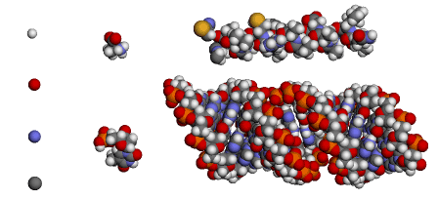
Growing the system complexity
Small molecules
Large molecules
Atoms

Slide 23
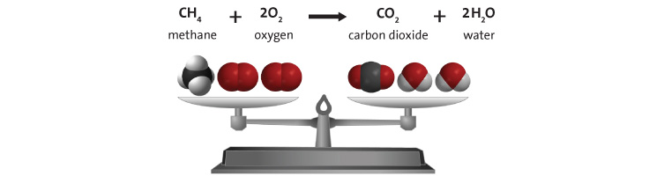
Stochatic simulation of chemical reactions
Check at the same time all the collisions is not efficient. Some algorithms have been proposed to avoid the computation expending.
Gillespiel’s simulation, at every iteration, decides which reaction will occur and when. Therefore, only effective collisions are computed, which can save substantially on simulation time.

Slide 24
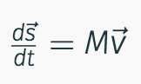
Continuos differential or discrete difference equations
The use of numerical approximation to describe the reactions over the time is a further step.
Here we can use a a big number of molecules, however one of the disadvantages of this approach is that concentrations could be o small that can not be represented by floating point numbers.

Slide 25
Metadynamics
It improves the equation model approach because it assumes that the number of species and therefore the number of equations may change over the time.
Differential equation system is changed by adding and/or removing equations
It combines the speed of a differential equation with the physical accuracy of a stochastic molecular collision simulation.

Slide 26
Comparison of reactor algorithms
Entities | Formalism | Interaction
Individual molecules | Stochastic molecular collisions | Collision and rule-based reactions
Molecular species | Stochastic simulation of chemical reactions | Possible reaction channels
Molecular species | Concentration/rate differential equations | Coupling between equations
Dominant molecular species and background | Meta-dynamics | Coupling between equations and random changes
Dominant molecular species and single molecules | Explicit simulation of molecules and ODE of dominant species | Coupling between equations and collision-based reactions of small number of molecules

Slide 27
Measuring time
One step on algorithm A, can be interpreted as a collision of two (or more) molecules.
Simulated time is :
# collisions / reactor size
One generation consists of M collisions.

Slide 28
Pattern Matching
Look for pattern matching is a central topic for DNA computing.
In the Tierra platform a pattern is given to follow instruction pointer into the program to be executed.
Accuracy of match can be used to calculate the probability of reaction or rate constants.
Hamming distance can be used to measure the distance for binary strings.
Hamming distance is the number of bits that differ between the two binary strings with fixed length.
String edit distance is used on an variable string length.

Slide 29
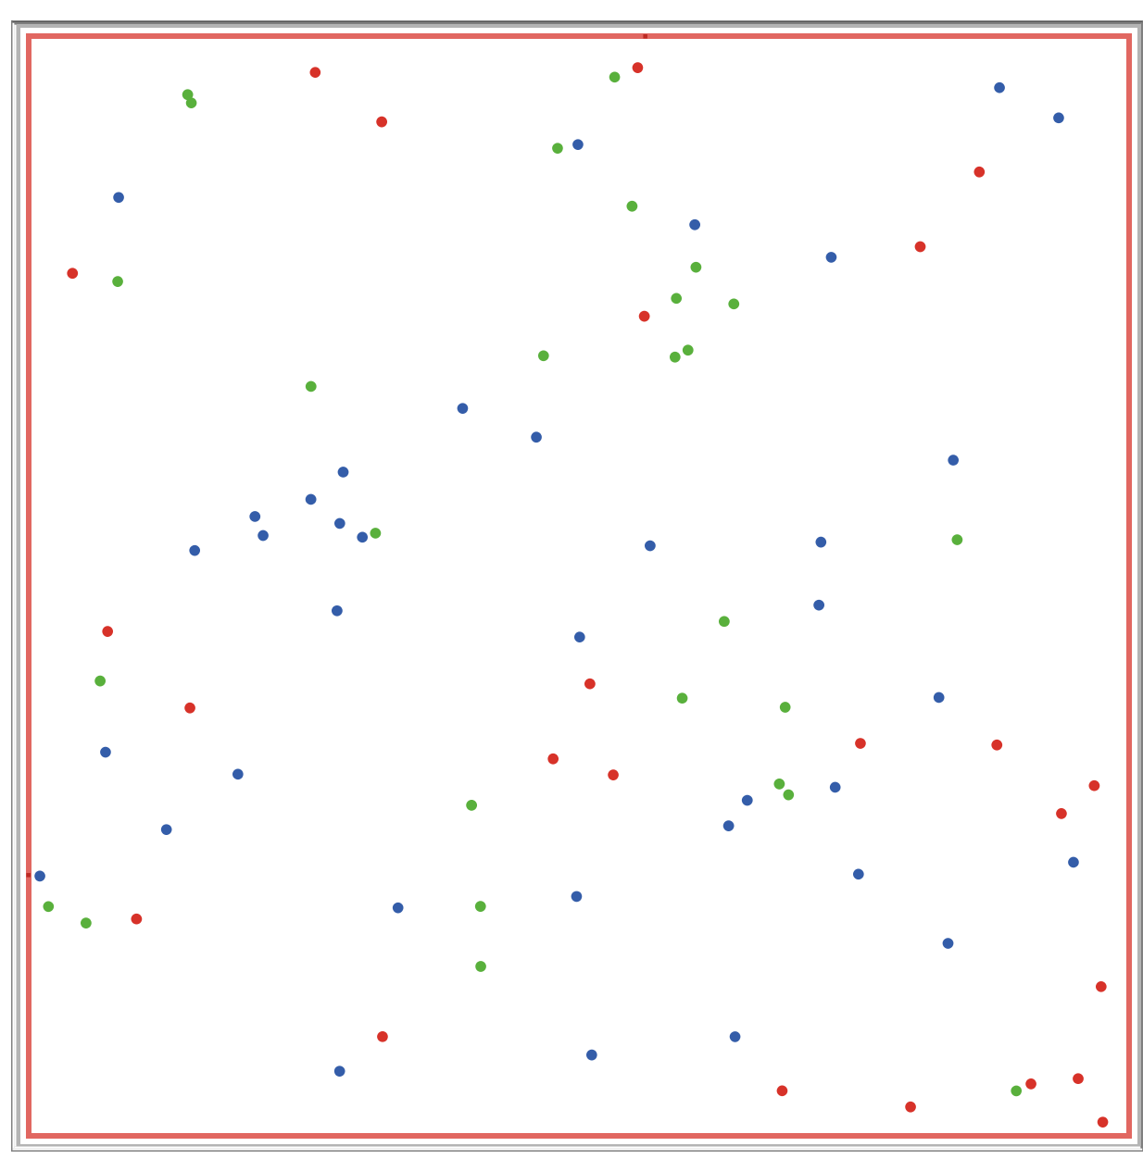
Spatial Topology
In a reactor with topology, the reaction probability depends on the neighborhood of a molecule S_{i} .
The topology/spatial metric has some influence on the selection of reactants by the algorithm A.
Well-stirred
Reactor with topology

Slide 30
Limited Resources
The limited resources often determine which models can be possibly simulated and examined and which not.
If <n> is the mean value of particles participating in each reaction r in R a reaction requires:
O(<n>) draw-operations.
O(R) lockups in the reaction rule set R.
So, we estimate a cost O(<n>)+O( R) for each reaction and it ca be approximated to O(R).
A full update requires: O(R.M) operations.
In ODE equations we requires N different equations. Assuming an integration step size h, we will get O(1/h * N * <n>) function evaluations.

Slide 31
Summary
We discussed general principles of chemistry and how chemical reactions can be modeled mathematically and simulated in a computer.
We have seen how complex chemical reactions networks can be formed from simple reactions.
We have discussed a number of frequently used terms and techniques in AC.

Slide 32

Which of the objects are stable?

Slide 33
The logic of bio-inspired computing and engineering
Methods developed in biologically-inspired fields are distinctive in that they focus on populations of agents that interact with each other and with the environment, generating bottom-up behavioral functional or structural patterns that can be interpreted as innovations.
Size scale

